Slide 1
FINAL
PRESENTATION
by:
VISHAKHA GUPTA
Mentored by:
RAGHAV BALI

Slide 2
Exploration of
different Langauage Models on various NLP Downstream Task
&
Deployment through FLASK

Slide 3
RECAP
BERT, BIOBERT architecture
Fined tuning for Question Answering as a downstream task and it’s procedure
BIO-ASQ dataset
Presentation of Question Answering system on BERT and BIO-BERT model through FLASK

Slide 4
BIOASQ DATASET
Bio-ASQ question answer dataset is taken from large-scale biomedical semantic indexing and question answering competition.
The dataset consists of 3266 questions in training set and 935 questions in development dataset.
BioASQ QA dataset is pre-processed publicly available dataset built in similar format of that of SQUAD dataset.
The dataset consists of question and a context answer which contains answer in form of span of text.

Slide 5
AGENDA
Overview of XLNET, RoBERTa and their medical domain counterparts
NMT model for language translation
Downstream tasks performed
Comparative view of all transformer based language models explored
Results
Roadblocks
Model demonstration through FLASK (DEMO)

Slide 6
FLOW CHART OF WORK DONE

Slide 7
NLP DOWNSTREAM TASKS
QUESTION ANSWERING
FILL IN THE MISSING WORDS
LANGUAGE
TRANSLATION
MODELS USED
MODEL USED
BERT
BIO-BERT CLINICAL-BERT
XLNET
RoBERTa
BIOMED-RoBERTa
NMT

Slide 8
MODELS EXPLORED
Different Downstream Task

Slide 9
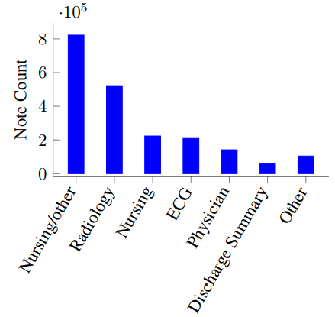
CLINICAL BIO-BERT
A model to use in clinical domain retaining the same architecture as that of BERT
Model is initialized from BioBERT & trained on all MIMIC notes.
Clinical text from the approximately 2 million notes in the MIMIC-III v1.4 database(electronic health records) comparising total of 0.88 Billion words.
Figure 1: Relative prevalence of MIMIC notes types.[1]

Slide 10
XLNET
Generalized Autoregressive Model, don’t rely on MASK technique
Leverages all possible permutations (both directions)
Leveraging transformer XL & designed with two stream self attention
Two stream self attention
Trained on total 160 GB of data comprising of total 32.89 Billion words. Corpus taken from Books Corpus(2.78B), Wiki(1.09 B), Giga5(4.75 B), Clue Web(4.30 B) & Common Crawl(19.97B)

Slide 11
ROBERTA
Roberta Researchers claimed BERT to be an undertrained model
Tuned hyperparameters of bert and increased training dataset size, trained longer with bigger batches.
Total dataset size is 160 GB, and text corpora is taken from Book Corpus(16GB), CCNews(76 GB),
Open Web Text (38 GB), stories(31 GB)
BIOMED-ROBERTA
Based on ROBERTA base
Trained ROBERTA base on 2.68 million scientific papers from semantic scholar corpus
Total 47 GB of data.(Full text of papers taken and not just abstracts)

Slide 12
COMPARATIVE VIEW
Different Downstream Task

Slide 13
KEY HIGHLIGHTS
XLNET
Generalized Auto -Regressive Model
Architecture derived from XL-Transformer
Permutation language model with two stream self attention
Sacrifices speed of training and inference in exchange for potentially better performance on complex tasks.
RoBERTa
Same architecture as that of BERT
Tuned Hyper Parameters of BERT
Larger dataset size
Next sentence prediction removed
BERT
Auto Encoder Model
Architecture derived from Transformer
BERT doesn’t use [MASK] in fine-tune step
Predicted tokens are assumed to be independent of each other

Slide 14
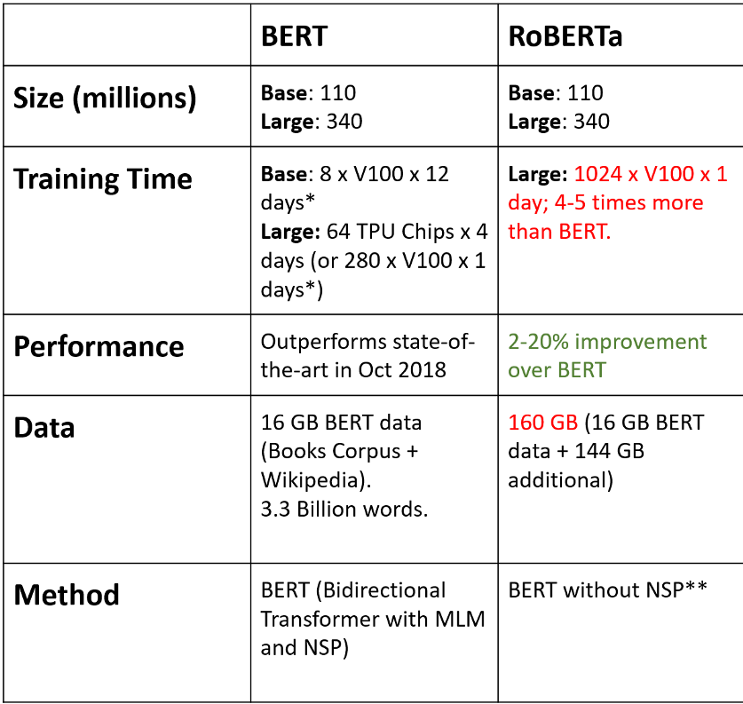
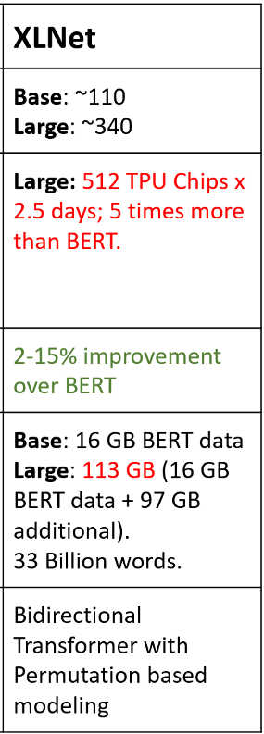
Comparative Study
Trained on 13 GB bert data + 145 GB additional. Total of 158 GB comprising of 32.8 Billion words

Slide 15
LANGUAGE TRANSLATION MODEL
NEURAL MACHINE TRANSLATION

Slide 16
NMT
Neural Machine Translation system is sequence to sequence model consisting of encoder & decoder with attention
The encoder encodes complete information as context vector.
In attention all the hidden states of encoder and decoder are used to generate context vector.

Slide 17
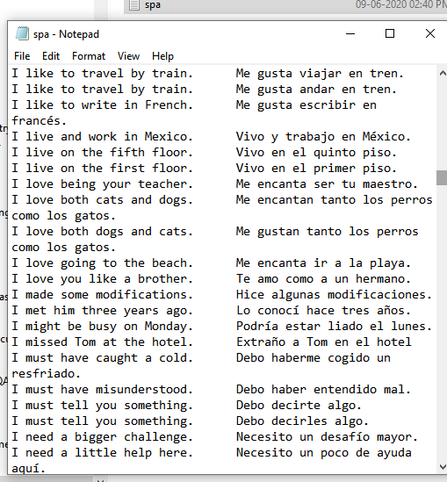
Dataset
Spanish to English translation using NMT model. The dataset used, consists of 1,18,964 sentences.

Slide 18
RESULTS
QUESTION ANSWERING ON BIO-ASQ DATASET

Slide 19
COMPARISON OF TRAINING TIME
 | No. Of EPOCH | TRAINING TIME PER EPOCH | TOTAL TIME
BERT | 5 | 10 min | 50 min
BIO-BERT | 5 | 10 min | 50 min
CLINICAL-BERT | 5 | 9 min | 45 min
ROBERTA | 5 | 15 min | 75 min
BIOMED ROBERTA | 5 | 15 min | 75 min
XLNET | 70 | 8 min | 9hr 20 min

Slide 20
COMPARISON OF RESULTS
 | No. Of EPOCH | EXACT MATCH SCORE | F1 SCORE
BERT | 5 | 60.59 | 62.71
BIO-BERT | 5 | 85.66 | 87.92
CLINICAL-BERT | 5 | 77.21 | 79.68
ROBERTA | 5 | 69.62 | 71.59
BIOMED ROBERTA | 5 | 80.86 | 83.44
XLNET | 70 | 43.74 | 47.52

Slide 21
GLIMPSES OF TRAINING
Question Answering on BIO-ASQ Dataset

Slide 22
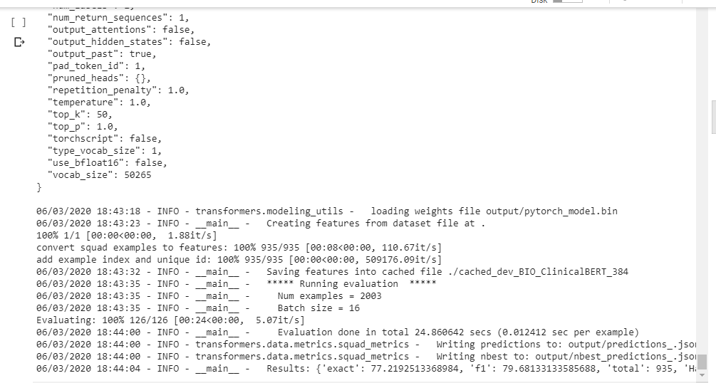
FINE TUNING ON CLINICAL-BERT

Slide 23
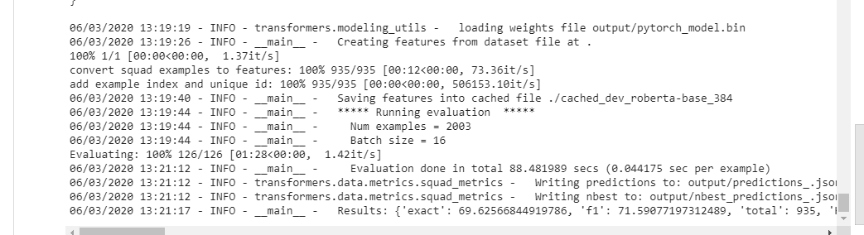
FINE TUNING ON ROBERTA

Slide 24
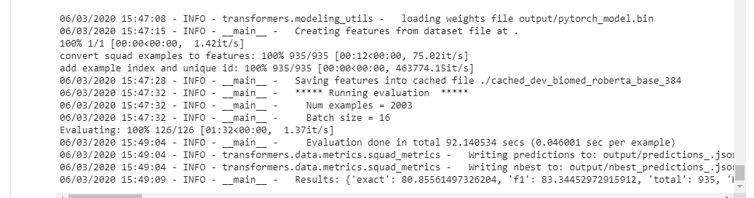
FINE TUNING ON BIOMED ROBERTA

Slide 25
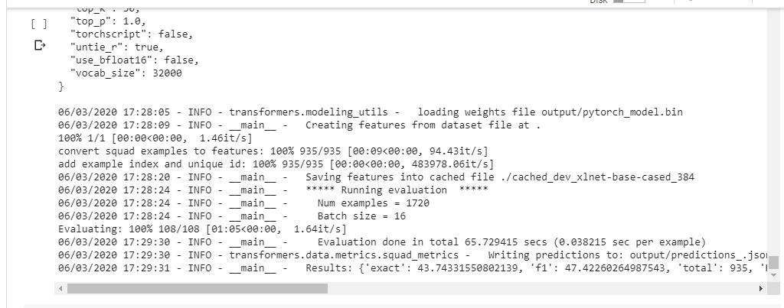
FINE TUNING ON XLNET

Slide 26
The complete code repository of my entire work is present on my github account.
Link for the same:
https://github.com/vishakhagupta10/nlp_model_demo

Slide 27
THANK YOU!

Slide 28
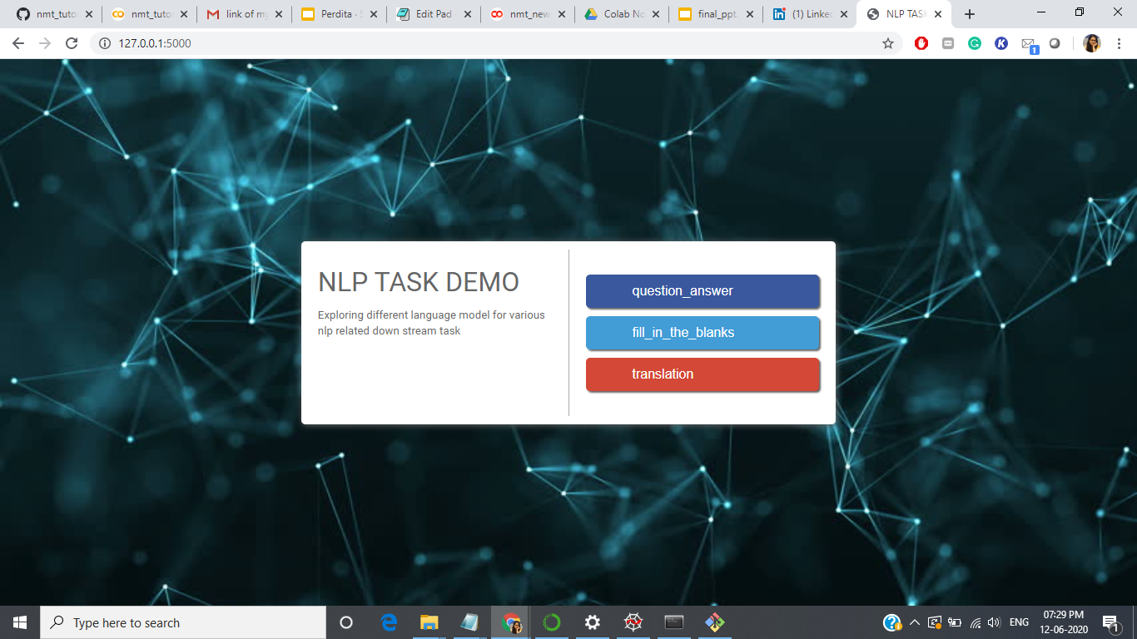

Slide 29
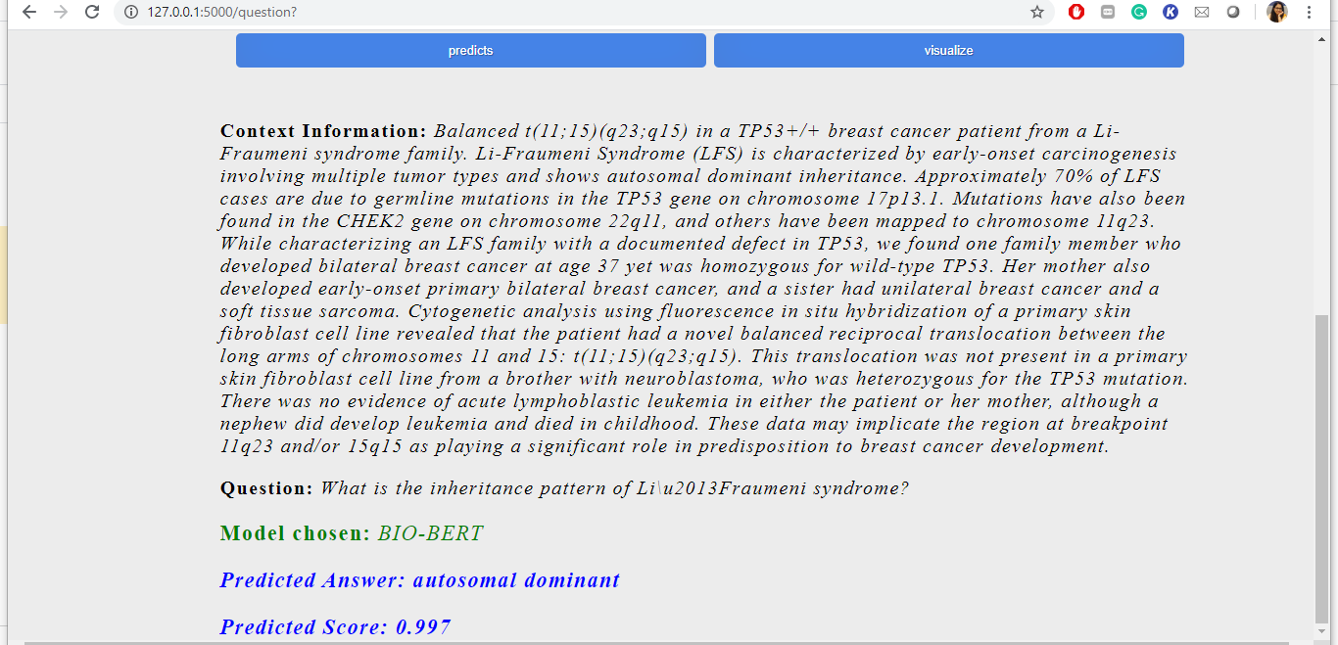
FINE TUNED BIOBERT

Slide 30
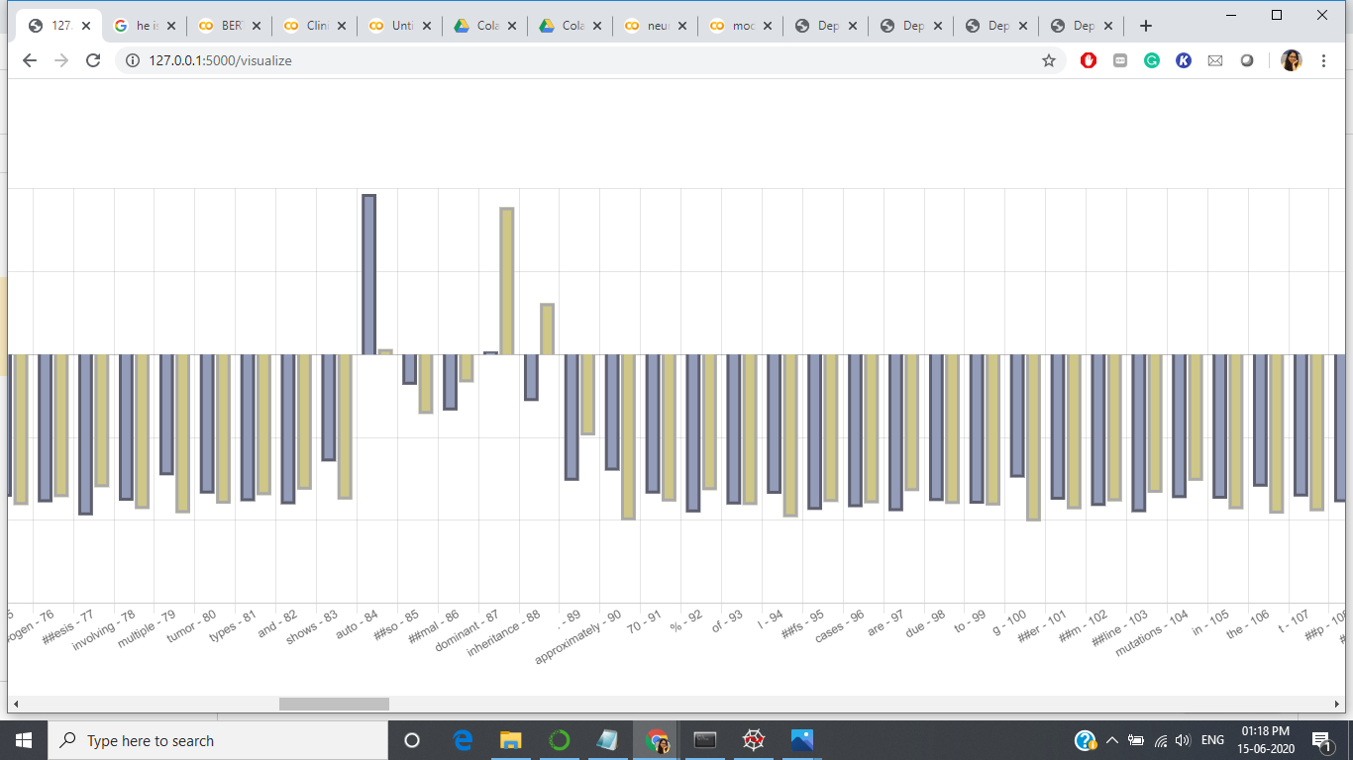
VISUALIZATION OF SCORE ON FINE TUNED BIOBERT

Slide 31
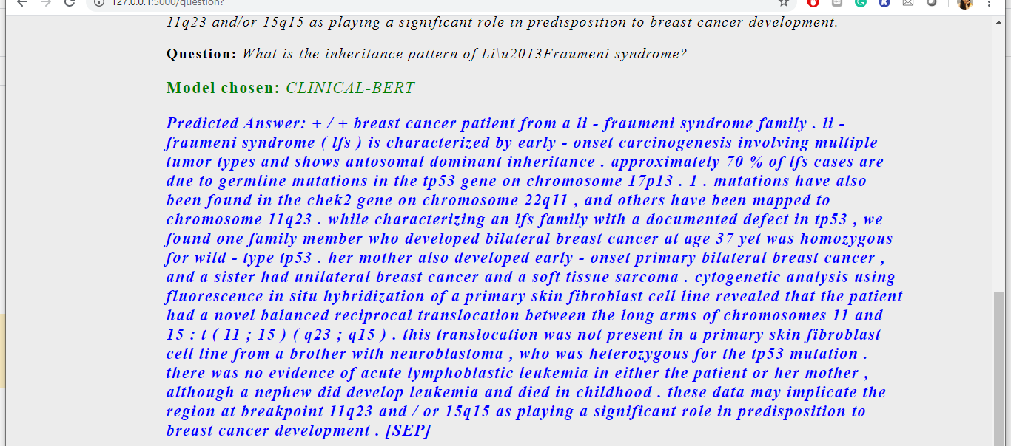
PRE TRAINED CLINICAL BERT

Slide 32
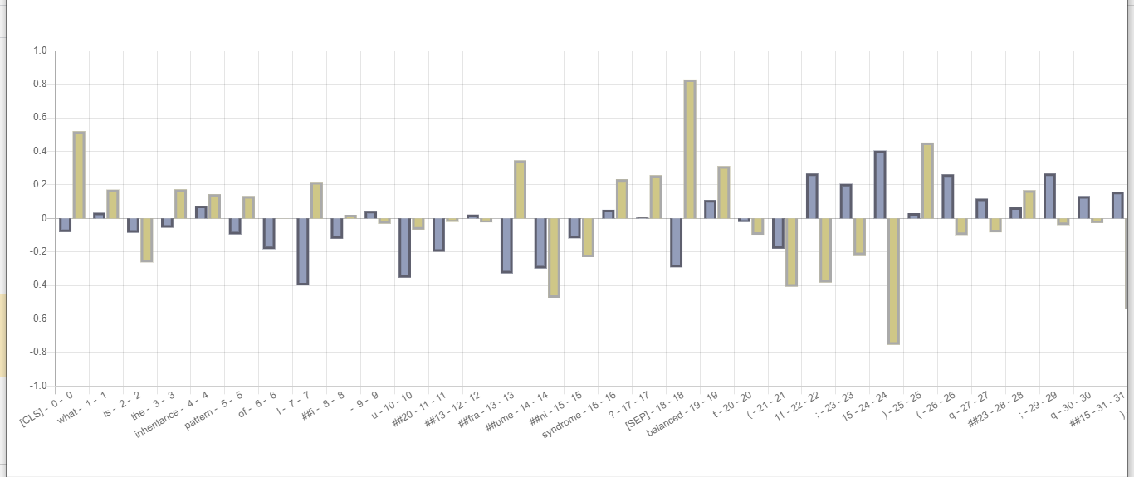
VISUALIZATION OF SCORE ON PRE TRAINED CLINICAL BERT

Slide 33
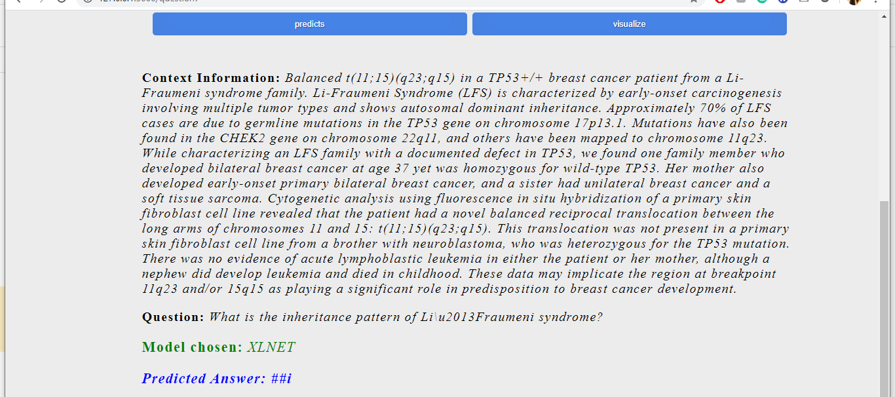
PRE TRAINED XLNET

Slide 34
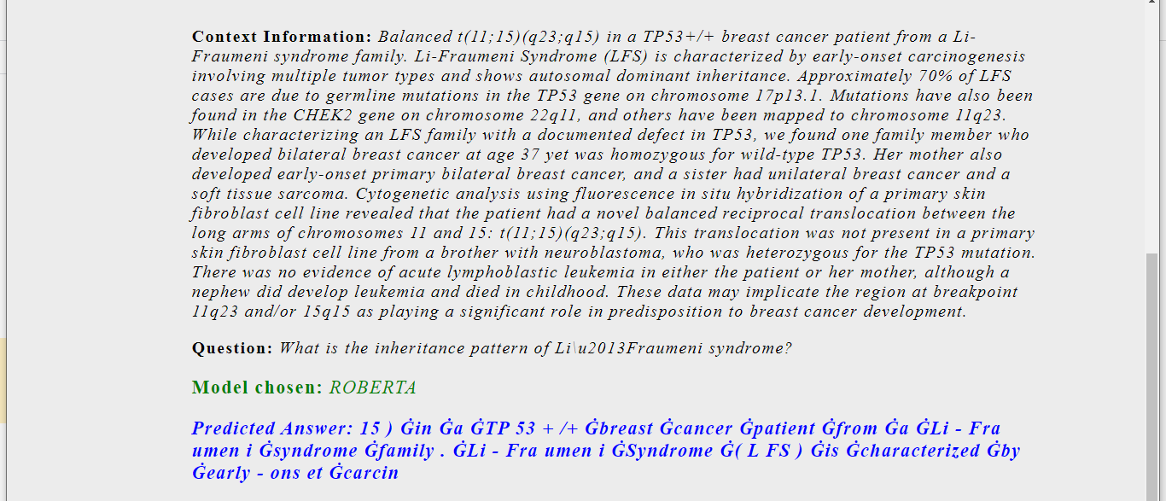
PRE TRAINED ROBERTA

Slide 35
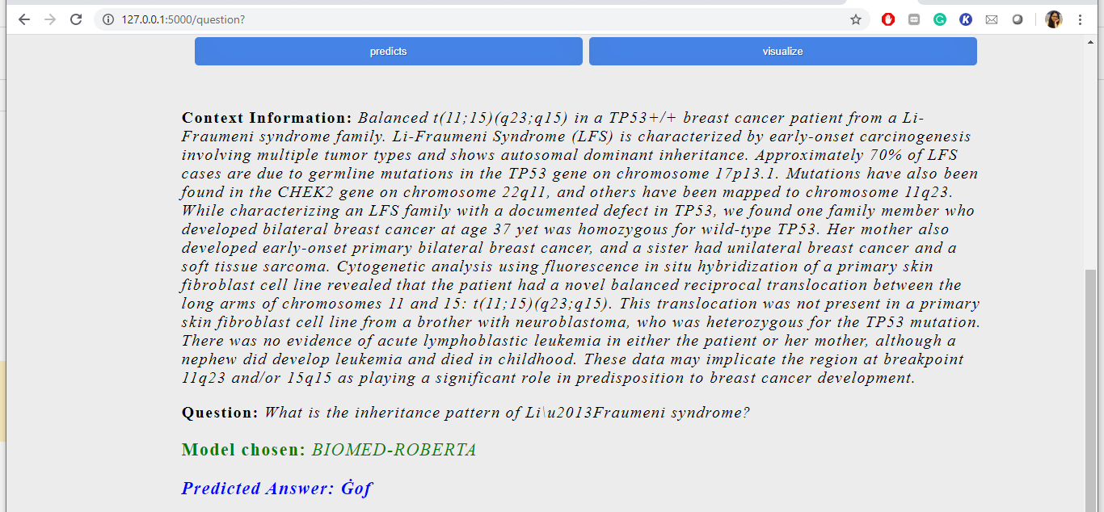
PRE TRAINED BIOMED-ROBERTA

Slide 36
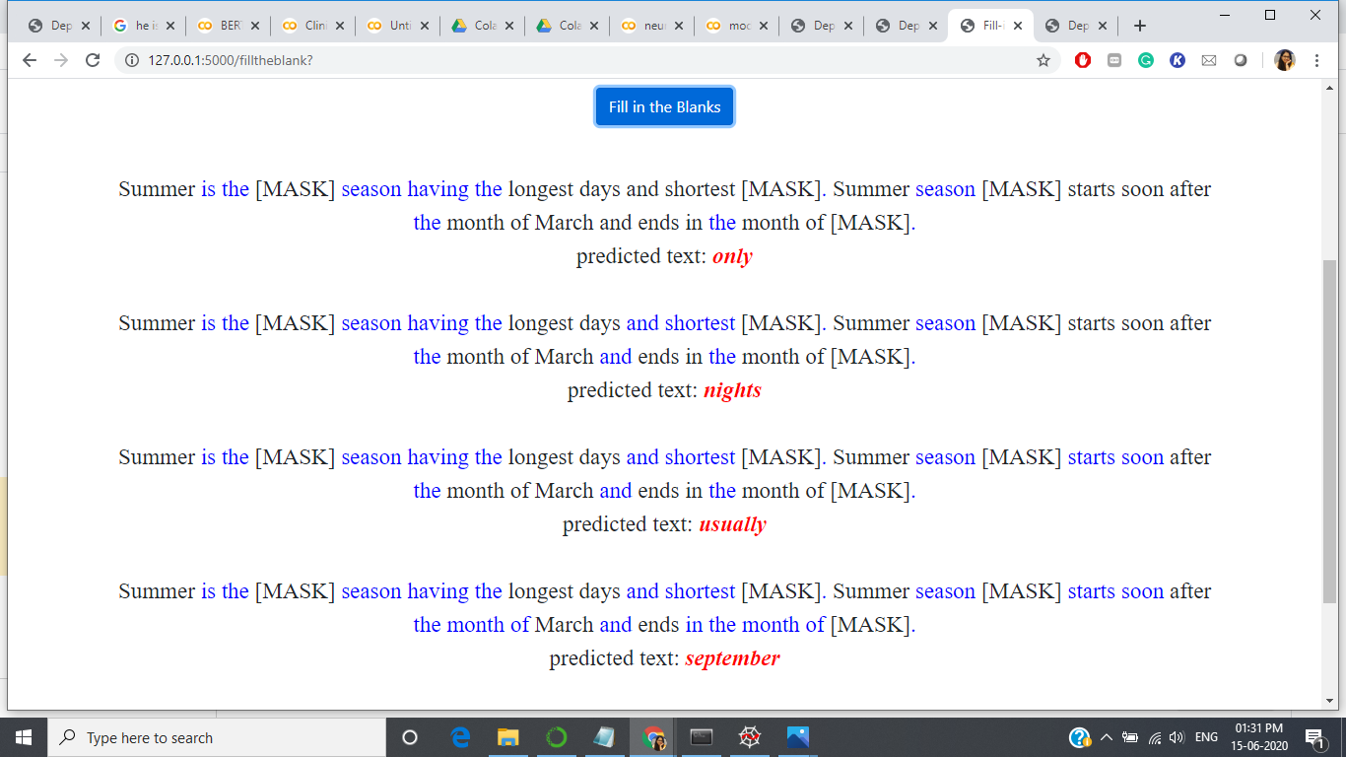
FILL IN THE MISSING WORDS

Slide 37
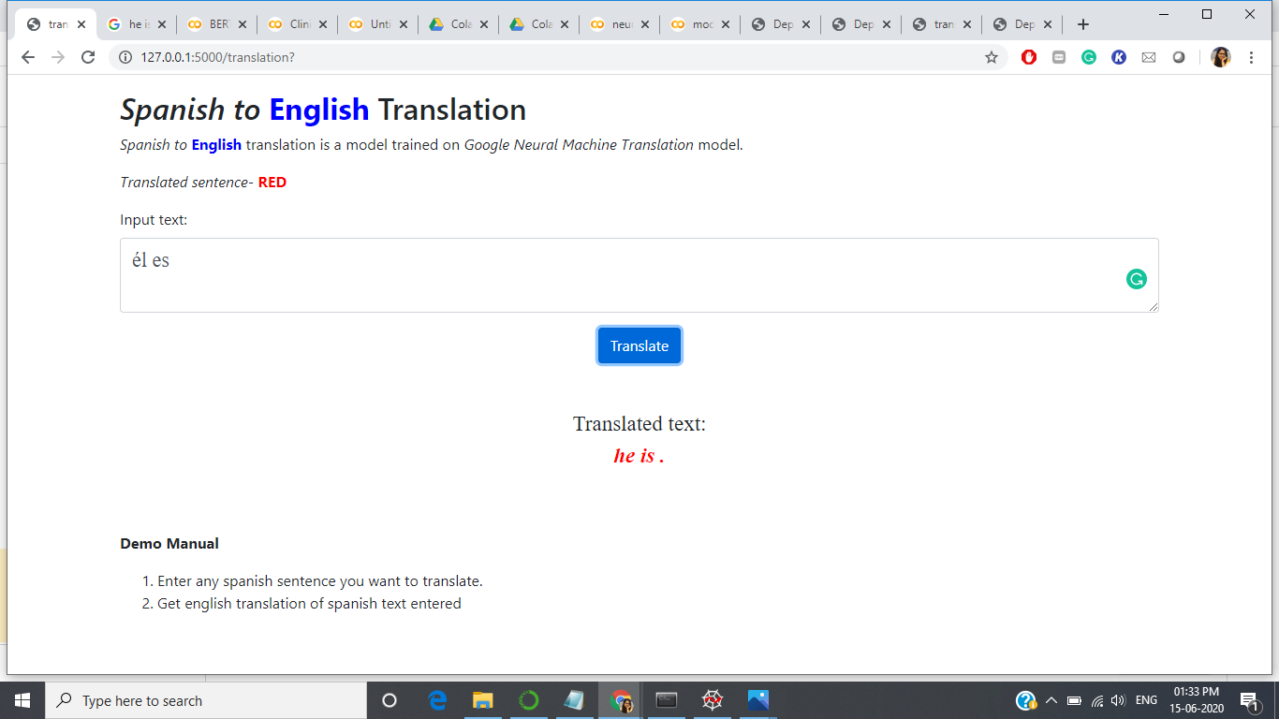
LANGUAGE TRANSLATION

